Slide 1

VALLURUPALLI NAGESWARA RAO VIGNANA JYOTHI INSTITUTE OF ENGINEERING AND TECHNOLOGY
Department of Computer Science and Engineering
Support Vector Machine
MACHINE LEARNING
BTech CSE (III Year-II Sem)
Dr. Kriti Ohri
Assistant Professor
Department of Computer Science and Engineering

Slide 2
Support Vector Machine
Support Vector Machine” (SVM) is a supervised machine learning algorithm which can be used for both classification or regression challenges.
A support vector machine (SVM) is a supervised machine learning model that uses classification algorithms for two-group classification problems. After giving an SVM model sets of labeled training data for each category, they’re able to categorize new text.
The objective of the support vector machine algorithm is to find a hyperplane in an N-dimensional space(N — the number of features) that distinctly classifies the data points.

Slide 3
Features of SVM:
SVM is a supervised learning algorithm. This means that SVM trains on a set of labeled data. SVM studies the labeled training data and then classifies any new input data depending on what it learned in the training phase.
A main advantage of SVM is that it can be used for both classification and regression problems. Though SVM is mainly known for classification, the SVR (Support Vector Regressor) is used for regression problems.
SVM can be used for classifying non-linear data by using the kernel trick. The kernel trick means transforming data into another dimension that has a clear dividing margin between classes of data. After which you can easily draw a hyperplane between the various classes of data.

Slide 4
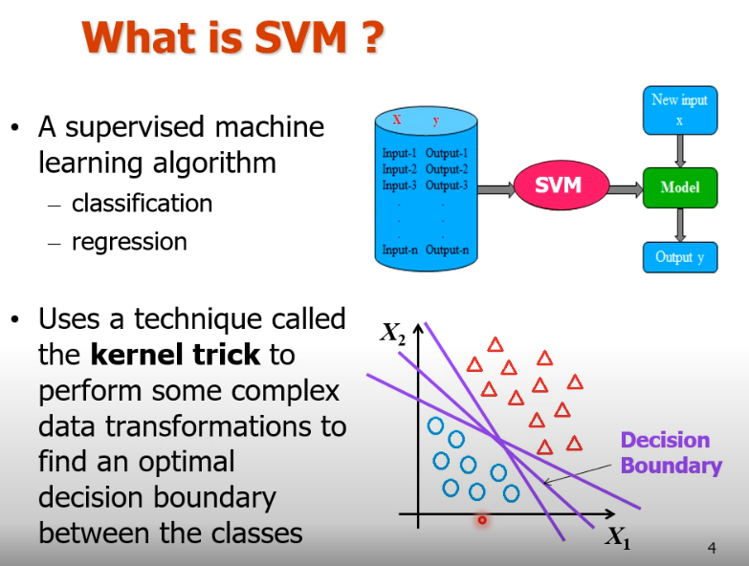

Slide 5
An SVM is implemented in a slightly different way than other machine learning algorithms. It is capable of performing classification, regression and outlier detection.
Support Vector Machine is a discriminative classifier that is formally designed by a separative hyperplane. It is a representation of examples as points in space that are mapped so that the points of different categories are separated by a gap as wide as possible. In addition to this, an SVM can also perform non-linear classification. Let us take a look at how the Support Vector Machine work.

Slide 6
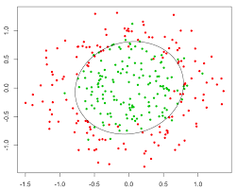
SVM supports non linear classification

Slide 7
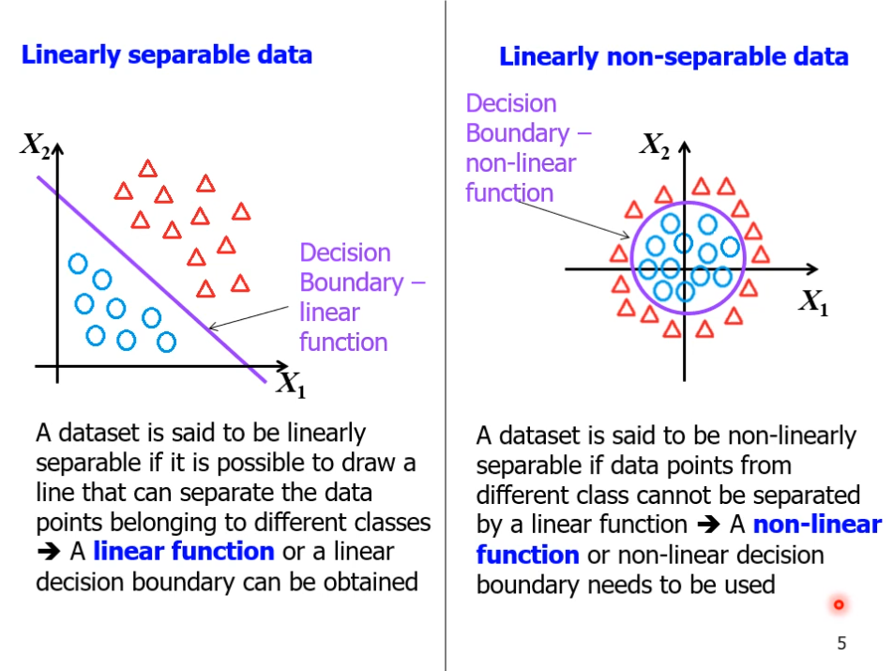

Slide 8
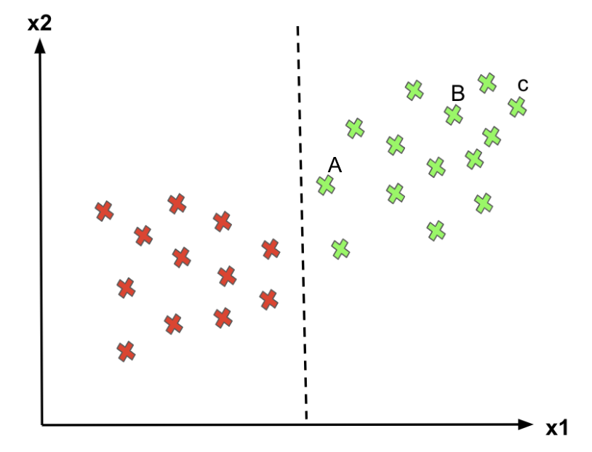
Problem with Logistic Regression
Logistic Regression helps solve classification problems separating the instances into two classes. However, there is an infinite number of decision boundaries, and Logistic Regression only picks an arbitrary one.
For point C, since it’s far away from the decision boundary, we are quite certain to classify it as 1 (green).
For point A, even though we classify it as 1 for now, since it is close to the decision boundary, if the boundary moves a little to the right, we would mark point A as “0” instead. Hence, we’re much more confident about our prediction at C than at A.
Logistic Regression doesn’t care whether the instances are close to the decision boundary. Therefore, the decision boundary it picks may not be optimal.
Therefore, the optimal decision boundary should be able to maximize the distance between the decision boundary and all instances. i.e., maximize the margins.

Slide 9
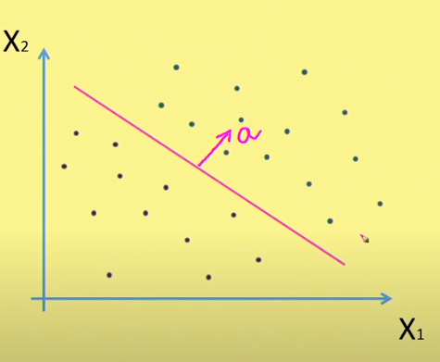
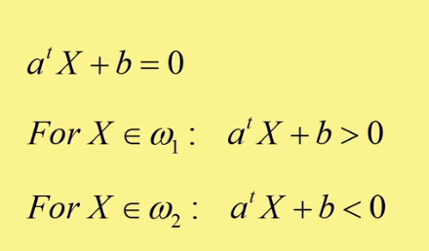
Logistic Regression Linear classifier –two class problem
Notes:
Positive and negative half space
A gives orientation and b gives position

Slide 10
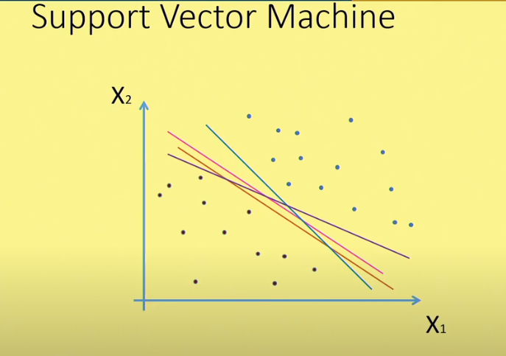
Which line best fits the data
Multiple lines can separate the region, but which one is best??
I have to identify which one is preferred , that’s where SVM comes.

Slide 11

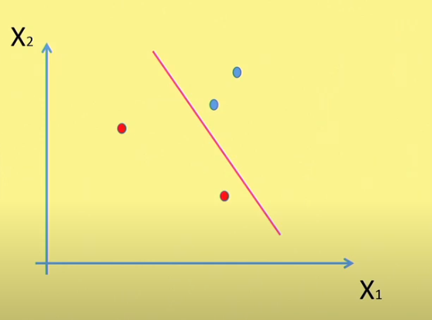
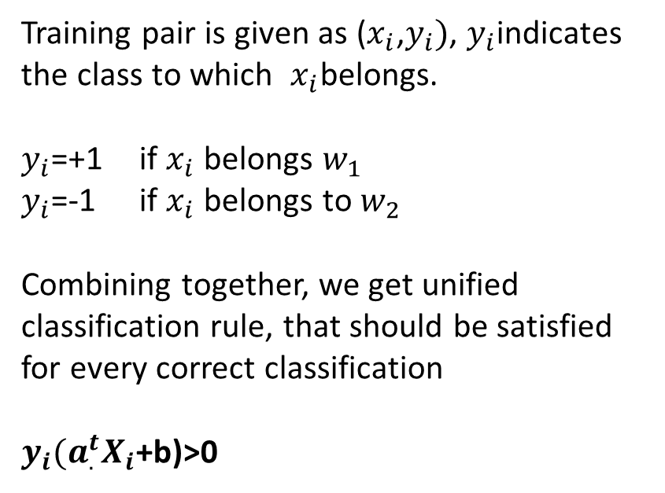
Training pair is given as ($x_{i}$,$y_{i})$, $y_{i}$indicates the class to which ${ x}_{i}$belongs.
$y_{i}$=+1 if $x_{i}$belongs $w_{1}$
$y_{i}$=-1 if $x_{i}$ belongs to $w_{2}$
Combining together, we get unified classification rule, that should be satisfied for every correct classification
$y_{i}{(a_{.}^{t}X}_{i}$+b)>0

Slide 12
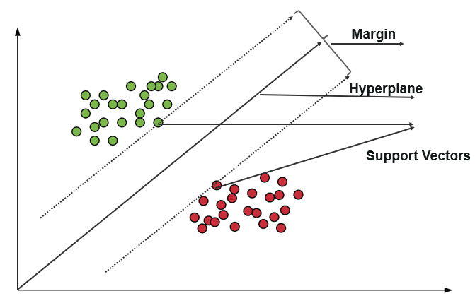
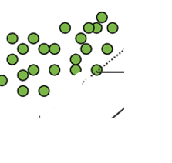
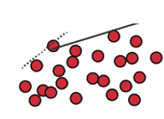
Important diagram for SVM
This distance from the decision surface to the closest data point determines the margin of the classifier
A hyperplane divides the space into two disconnected parts.
Support vectors are data points that are closer to the hyperplane and influence the position and orientation of the hyperplane. Using these support vectors, we maximize the margin of the classifier. This distance from the decision surface to the closest data point determines the margin of the classifier
Margin is more
Margin is less
(Not a good choice)

Slide 13
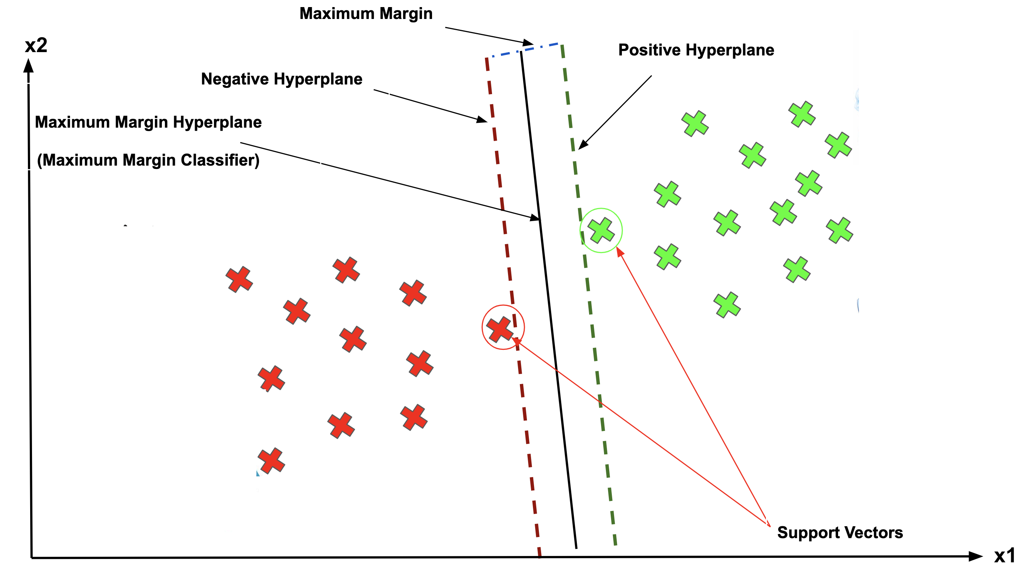
Support Vector Machine
The objective of applying SVMs is to find the best line in two dimensions or the best hyperplane in more than two dimensions in order to help us separate our space into classes. The hyperplane (line) is found through the maximum margin, i.e., the maximum distance between data points of both classes.
Support Vector, Hyperplane, and Margin
The vector points closest to the hyperplane are known as the support vector points.
The dimension of the hyperplane depends upon the number of features. If the number of input features is 2, then the hyperplane is just a line. If the number of input features is 3, then the hyperplane becomes a two-dimensional plane. It becomes difficult to imagine when the number of features exceeds 3.
The distance of the vectors from the hyperplane is called the margin, which is a separation of a line to the closest class points.

Slide 14
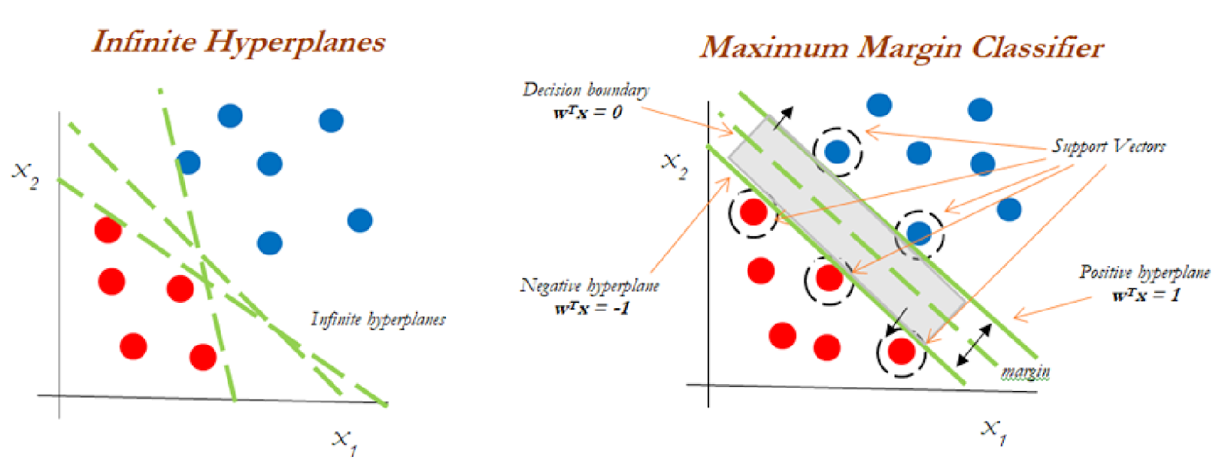
From the above diagram, we can assume infinite hyperplanes(left). The maximum margin classifier comes with a single hyperplane that divides the data(right). The data touching the positive and negative hyperplanes is referred to as support vectors.

Slide 15
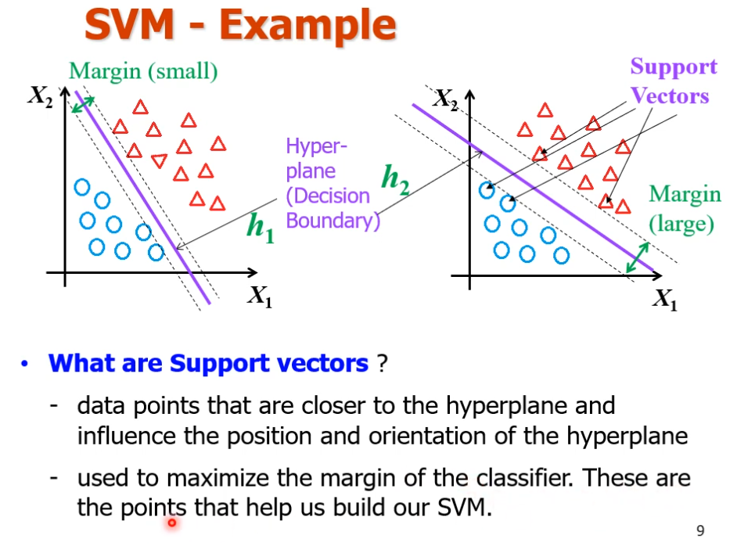

Slide 16
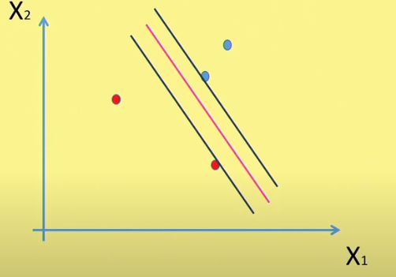
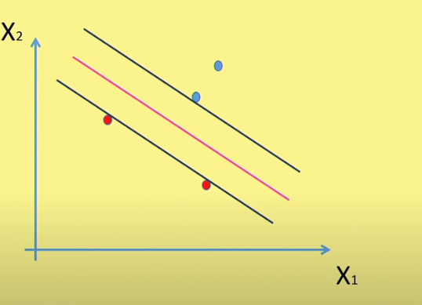
Margin is less
Margin is more

Slide 17



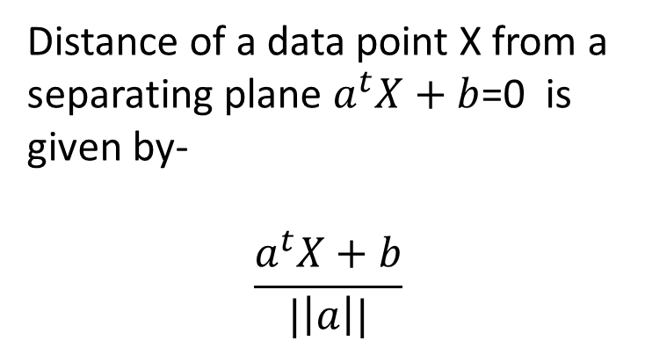
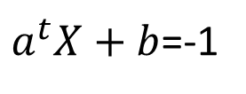
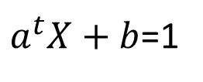
Distance of a data point X from a separating plane $a^{t}X+b$=0 is given by-
$$\frac{a^{t}X+b}{|\left|a\right||}$$
$a^{t}X+b$=1
$a^{t}X+b$=-1
More the distance of a point x from the separating plane more is the confidence that a sample is classified correctly

Slide 18
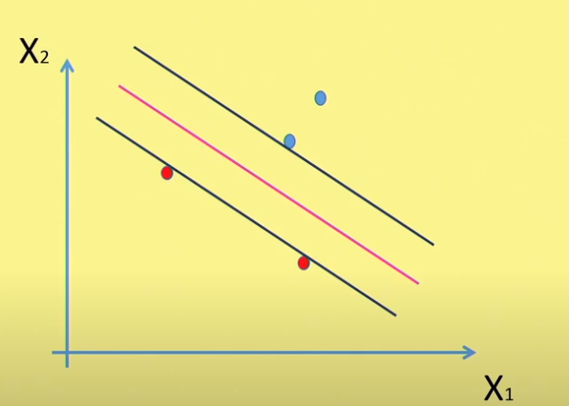


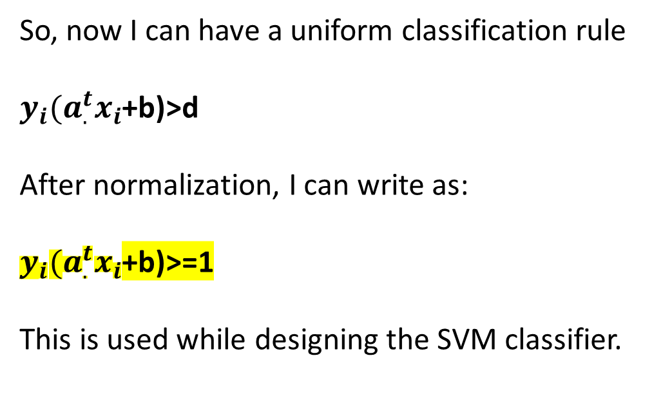


$$a^{t}x+b>d$$
If x belongs to w1 class
$$a^{t}x+b<−d$$
If x belongs to w2 class
Where, d is the threshold
So, now I can have a uniform classification rule
$y_{i}{(a_{.}^{t}x}_{i}$+b)>d
After normalization, I can write as:
$y_{i}{(a_{.}^{t}x}_{i}$+b)>=1
This is used while designing the SVM classifier.

Slide 19
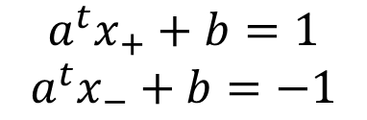
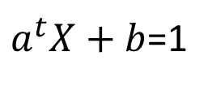
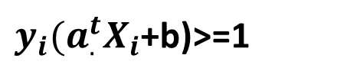
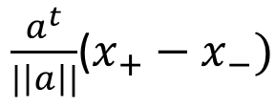
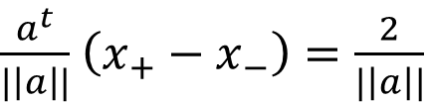


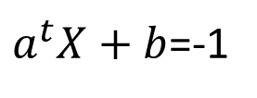
Margin has to be maximized
$$a^{t}x_{+}+b=1$$
$$a^{t}x_{−}+b=−1$$
$$a^{t}\left(x_{+}−x_{−}\right)=2$$
Unit vector in the direction of a
$\frac{a^{t}}{|\left|a\right||}$($x_{+}−x_{−})$
$$\frac{a}{|\left|a\right||}$$
margin
$\frac{a^{t}}{|\left|a\right||}$ $\left(x_{+}−x_{−}\right)=\frac{2}{|\left|a\right||}$
$a^{t}X+b$=1
We need to maximize the margin but keeping the constraint in mind i.e.
$a^{t}X+b$=-1
$y_{i}{(a_{.}^{t}X}_{i}$+b)>=1
Hence, it becomes a constraint optimization problem which is solved by Lagrangian
Notes:
Draw a vector from x_ to x+. Margin is given by the dot product of vector x_ to x+ with unit vector in the direction of w

Slide 20
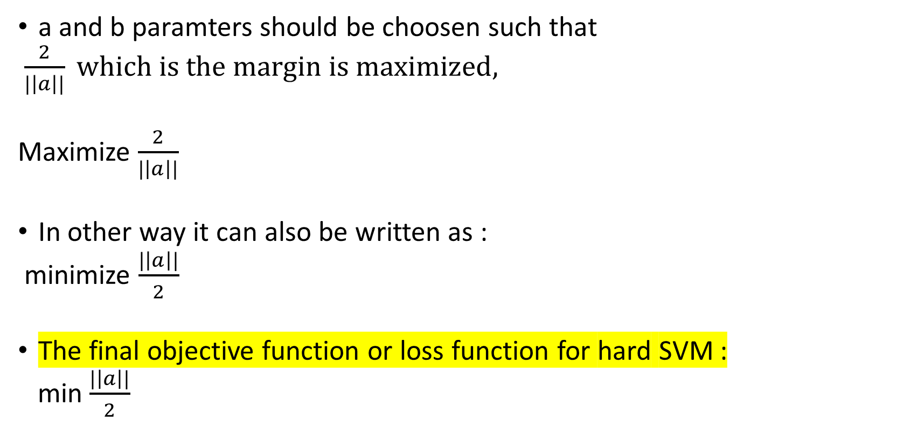
a and b paramters should be choosen such that
$\frac{2}{|\left|a\right||} which is the margin is maximized,$
Maximize $\frac{2}{|\left|a\right||}$
In other way it can also be written as :
minimize $\frac{|\left|a\right||}{2}$
The final objective function or loss function for hard SVM :
min $\frac{|\left|a\right||}{2}$

Slide 21
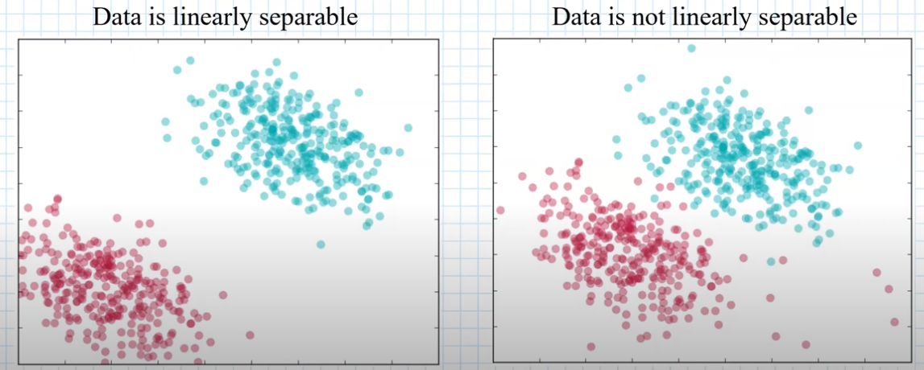
Hard SVM and Soft SVM
Data has noise
Cannot use hard SVM, use soft SVM as data of both classes is intermingled.
Slack variables εi can be added to allow misclassification of difficult or noisy examples.
Can use Hard SVM
Hard Margin: requires that all data points are classified correctly
Sensitive to outliers

Slide 22
Hard SVM (Hard-Margin SVM)
Definition: A hard-margin SVM assumes that the data is perfectly linearly separable, meaning that there exists a hyperplane that can separate the two classes without any misclassifications.
Key Idea: The algorithm tries to find the hyperplane that maximizes the margin (the distance between the hyperplane and the closest data points, known as the support vectors) while ensuring that no data points are misclassified.
Characteristics:
Strictly Linear Separation: All the data points must lie on the correct side of the margin (i.e., no points are allowed to fall inside the margin or be misclassified).
No Tolerance for Misclassifications: There is zero tolerance for classification errors or margin violations. If the data isn't linearly separable, a hard SVM cannot be used.
Optimal for Clean Data: Hard SVM works well only when the data is perfectly separable and free of noise or outliers. It fails to handle datasets with noise or overlapping classes because it tries to fit a strict linear boundary.

Slide 23
Soft-Margin SVM
Definition: A soft-margin SVM relaxes the requirement that the data must be perfectly linearly separable. It allows some data points to violate the margin or even be misclassified. The goal is to find a balance between maximizing the margin and minimizing classification errors.
Key Idea: Instead of insisting that every point be classified correctly, the soft SVM introduces slack variables to allow some points to fall within the margin or be misclassified. This makes it more flexible in dealing with real-world data that may contain noise, overlaps, or outliers.
Definition: A soft-margin SVM relaxes the requirement that the data must be perfectly linearly separable. It allows some data points to violate the margin or even be misclassified. The goal is to find a balance between maximizing the margin and minimizing classification errors.
Key Idea: Instead of insisting that every point be classified correctly, the soft SVM introduces slack variables to allow some points to fall within the margin or be misclassified. This makes it more flexible in dealing with real-world data that may contain noise, overlaps, or outliers.

Slide 24
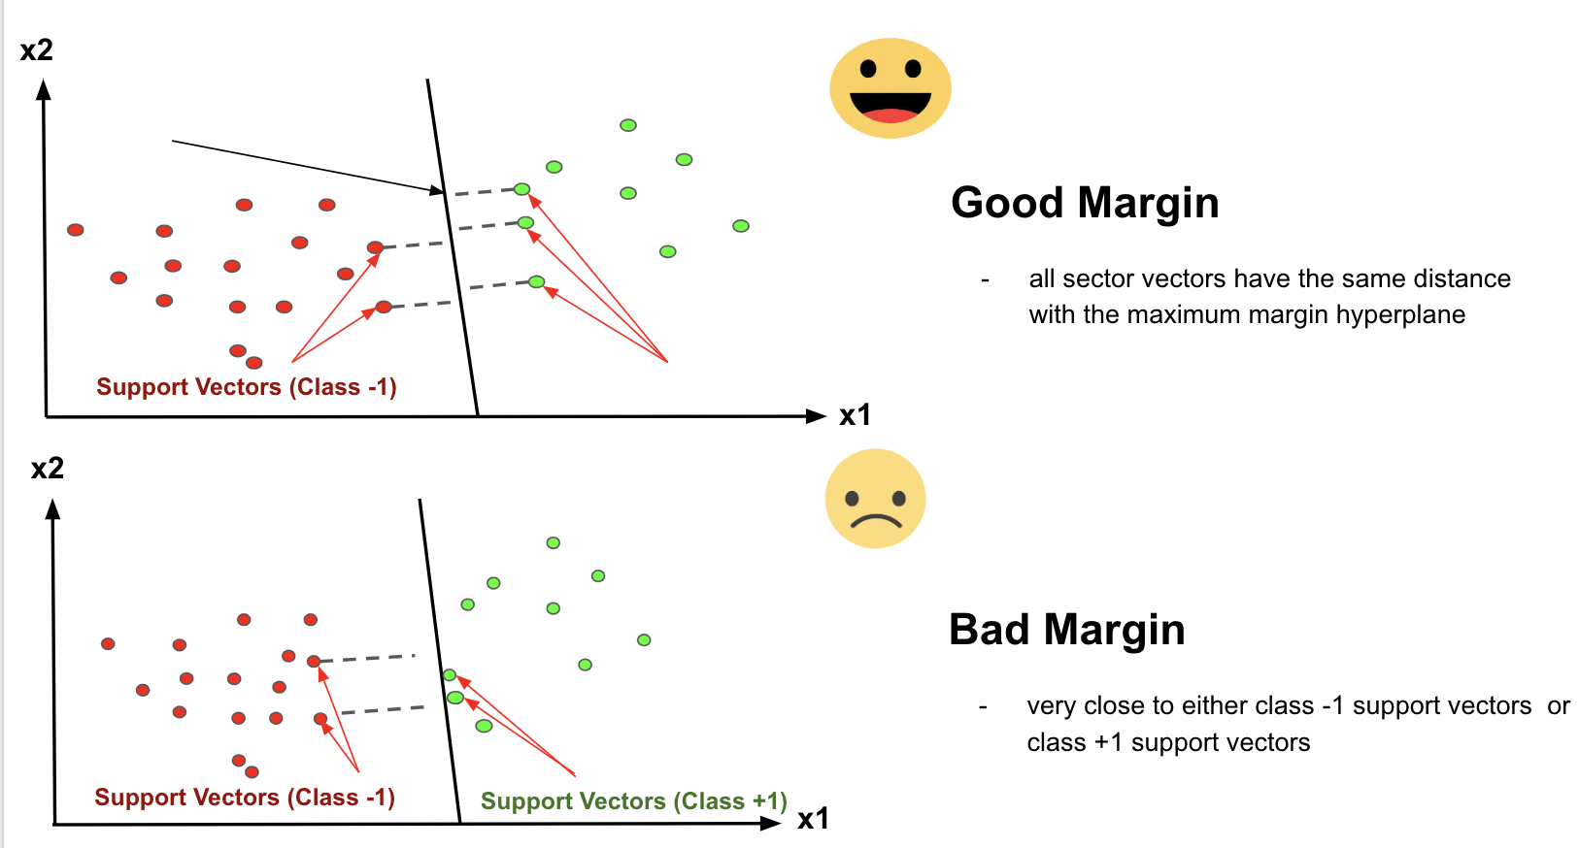
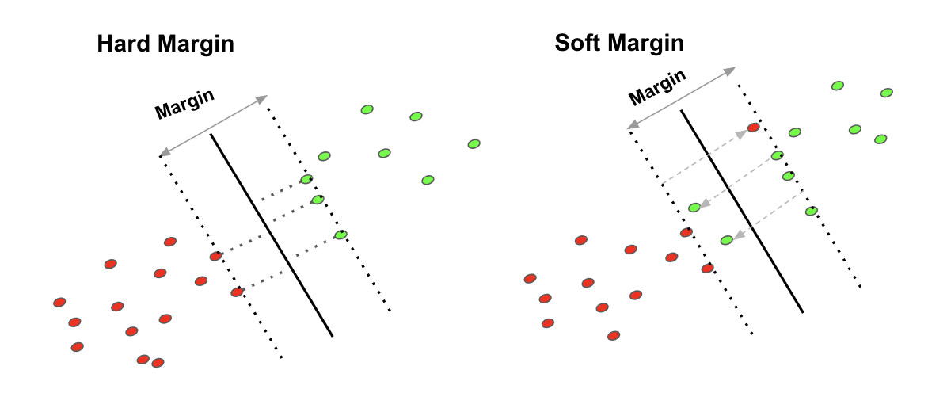
Hard Margin
If the training data is linearly separable, we can select two parallel hyperplanes that separate the two classes of data, so that the distance between them is as large as possible.
Soft Margin
As most of the real-world data are not fully linearly separable, we will allow some margin violation to occur, which is called soft margin classification.
In order to find the maximal margin, we need to maximize the margin between the data points and the hyperplane.

Slide 25
Hard-margin SVMs fail if data is not linearly separable and is sensitive to outliers. The goal of hard-margin SVMs is to find a hyperplane H that maximizes the margin m.
Soft SVM allows few points to violate margin with slack variables.
A soft-margin SVM modifies the constraints from the hard-margin SVM by allowing some points to violate the margin. Soft Margin deals with noisy data and misclassifications.
Our objective is that we want to Maximize margin with noise using soft SVM

Slide 26
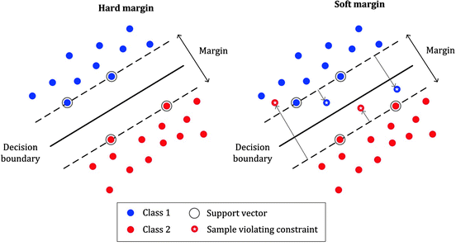
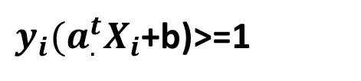
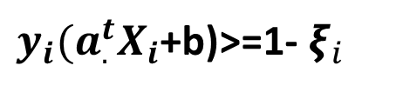
Hard SVM and Soft SVM
𝞷_4
𝞷_2
𝞷_3
𝞷_1
$y_{i}{(a_{.}^{t}X}_{i}$+b)>=1
$y_{i}{(a_{.}^{t}X}_{i}$+b)>=1- $ξ_{i}$

Slide 27
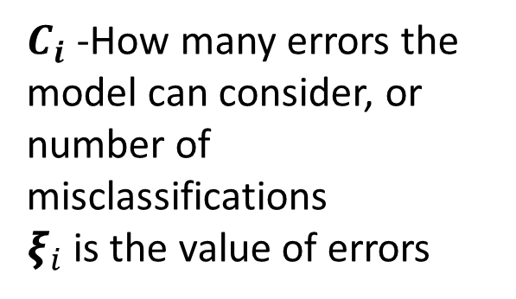

The final objective function or loss function is (for soft SVM):
min $\frac{|\left|a\right||}{2}$+ $C_{i}\sum_{i}^{N}{ξ_{i}}$
$C_{i}$-How many errors the model can consider, or number of misclassifications
$ξ_{i}$ is the value of errors

Slide 28
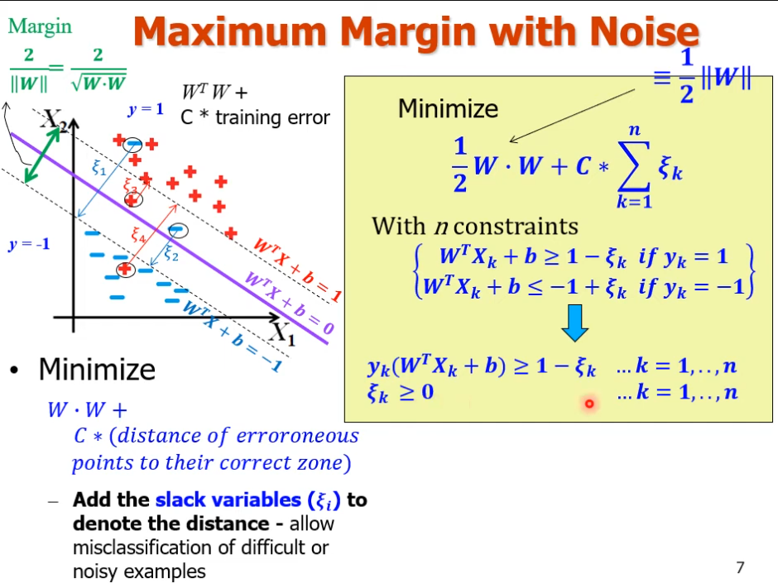
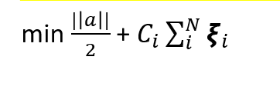

Slide 29
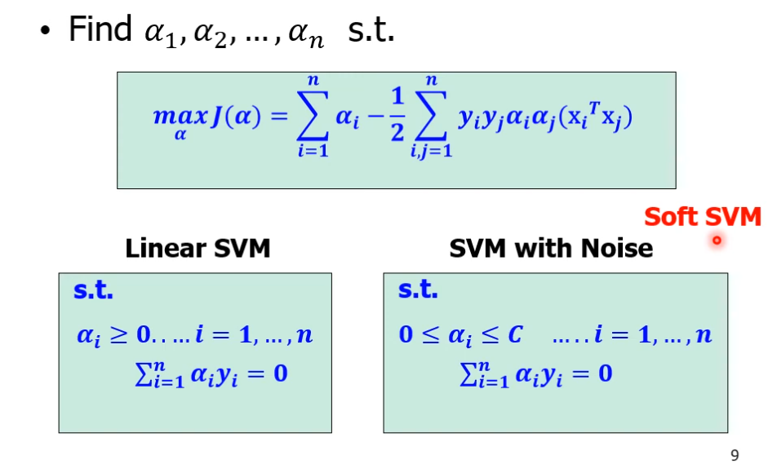
Dual formulation

Slide 30
Summary of Key Concepts:
Margin Maximization: Maximizes the separation between classes.
Support Vectors: Key data points that define the decision boundary.
Kernel Trick: Allows non-linear data to be separated by mapping it to a higher-dimensional space.
Effective in High Dimensions: Handles datasets with a large number of features well.
Soft Margin: Deals with noisy data and misclassifications.
SVM is a versatile and effective algorithm for both classification and regression, especially when there is a clear margin between classes.

Slide 31
Advantages of SVM
Effective in high dimensional spaces
Still effective in cases where the number of dimensions is greater than the number of samples
Uses a subset of training points in the decision function that makes it memory efficient
Different kernel functions can be specified for the decision function that also makes it versatile
SVM is less prone to overfitting
Works Well for Binary and Multi-Class Classification
Support for Linear and Non-Linear Classification
SVM for Outlier Detection
Disadvantages of SVM
If the number of features is much larger than the number of samples, avoid over-fitting in choosing kernel functions and regularization term is crucial.
SVMs do not directly provide probability estimates, these are calculated using five-fold cross-validation.

Slide 32
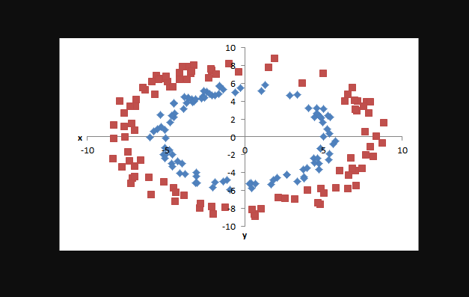
Dual formulation
Now, let’s consider the case when our data set is not at all linearly separable.
basically, we can separate each data point by projecting it into the higher dimension by adding relevant features to it as we do in logistic regression. But with SVM there is a powerful way to achieve this task of projecting the data into a higher dimension.
The alternative method is dual form of SVM which uses Lagrange’s multiplier to solve the constraints optimization problem.

Slide 33
Applications of SVM in Real World
SVMs depends on supervised learning algorithms. The aim of using SVM is to correctly classify unseen data. SVMs have several applications in several fields. Some common applications of SVM are-
Face detection – SVMc classify parts of the image as a face and non-face and create a square boundary around the face.
Text and hypertext categorization – SVMs allow Text and hypertext categorization for both inductive and transductive models. They use training data to classify documents into different categories. It categorizes on the basis of the score generated and then compares with the threshold value.
Classification of images – Use of SVMs provides better search accuracy for image classification. It provides better accuracy in comparison to the traditional query-based searching techniques.
Bioinformatics – It includes protein classification and cancer classification. We use SVM for identifying the classification of genes, patients on the basis of genes and other biological problems.
Protein fold and remote homology detection – Apply SVM algorithms for protein remote homology detection.
Handwriting recognition – We use SVMs to recognize handwritten characters used widely.
Generalized predictive control(GPC) – Use SVM based GPC to control chaotic dynamics with useful parameters.

Slide 34
References
https://www.youtube.com/watch?v=7vSGI9FCCaY
https://www.youtube.com/watch?v=kcQ0RzLfB_0
Lecture 12 : Support Vector Machine - II - YouTube

